Slide 1
Share Files & Folders Between Your Host Machine and VirtualBox

Slide 2
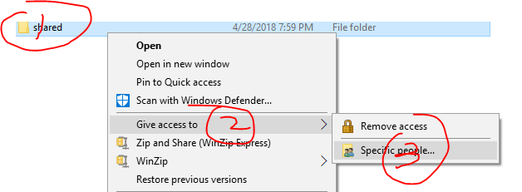
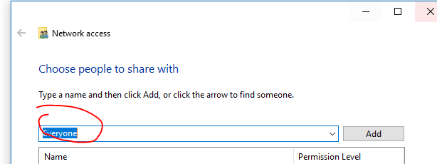
Step 1: Create a folder on Host

Slide 3
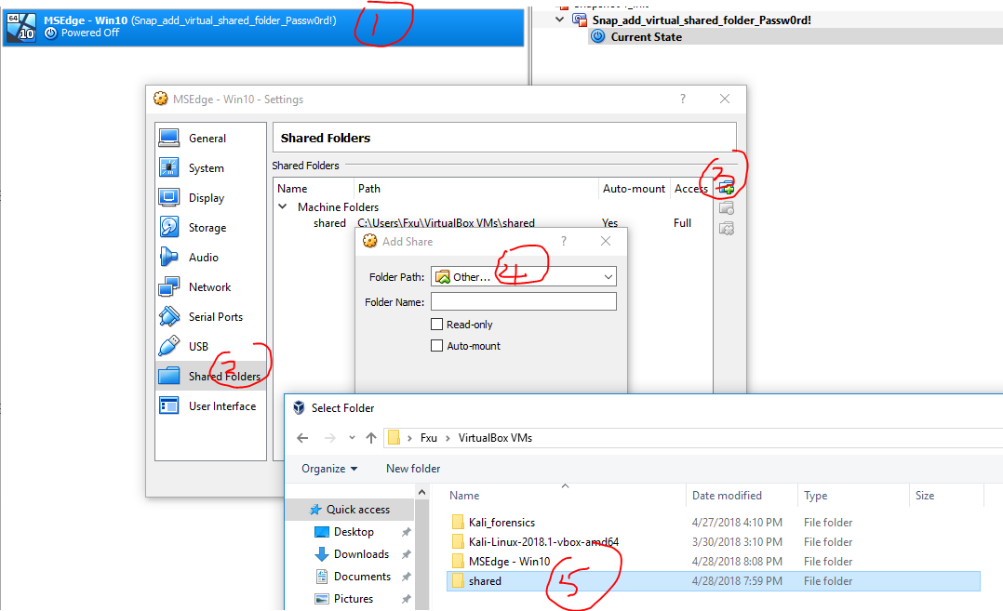
Step 2: Add the shared folder

Slide 4
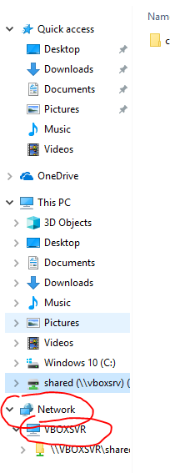
Step 3: Discover the shared folder on Guest machine
You have to type the password to log on Window if you using Window: Pass0rd!

